Slide 1
TN ROVER
We are here to locate

Slide 2


Motto
Discover the Undiscovered
It contains the public amenities that are to be known by the users.

Slide 3
Introduction
This project named TNROVER is being developed based on the system of Agile Methodologies. Here, a team of six members Thamizselvan A (20CSR224), Vaibhav S (20CSR227), SriSanjai N (20CSR208), Sharath S (20CSR194), Yogavarshan S (20CSR241), Viswa V (20CSR239) have split the roles among a team based on the concept of Agile Methodology.
In our Project, We are providing the list of top visiting places information at each locations.

Slide 4
Objective
To create a web application for tourist and public amenity management system named as TNROVER.
The main objective of this tourist and public amenity management website is to regulate the information of various cities in Tamilnadu.

Slide 5
Existing System
Not providing details for multiple places. i.e., School, Hotel, Theatre, Temple
They make benefit only to their organization. It looks like Business Oriented Model
1
3
There is no options like Location direction,
Redirecting website etc… for each categories
2
4
There are not providing all together

Slide 6
Proposed System
Here it will be an User centric project which is built using Agile principles
We are providing the locations and details for each and every public amenities in a particular city
1
3
2
Implemented options like location,
Booking website redirections which will make users more convenient
We listed the top places at every locations
4

Slide 7
Requirements
Functional | Non-Functional
Cities Home | Login
City Detials | About Us
Place Details | Theatre Ticket Booking
Reviews | Menu Cards for each Restaurants
Location Navigation | Redirection to the Org. Website

Slide 8
List of Modules
Login Page
Home Page
About Page
City Page
Amenity Page
Location (Google Map)
Redirection(Org. Website)

Slide 9
Login Page
User Story
Acceptance Criteria
As a User
I need an user account to save the visited places.
The user can login via Login page. If the user doesn’t have account he/she can create an account.

Slide 10
Home Page
User Story
Acceptance Criteria
As a User
I want the top cities in the home page that will be more convenient.
Home page provides the list of top cities.

Slide 11
About Page
User Story
Acceptance Criteria
As a User
I want to know about why the project is started and information about the project.
User can able to see all the information about the project in About Page.

Slide 12
City Page
User Story
Acceptance Criteria
As a User
I want brief details about the city and categories of places must be displayed.
User can see the details about the city and at the bottom the categories has displayed.

Slide 13
Amenity Page
User Story
Acceptance Criteria
As a User
I want all the amenities with the contact details and locations.
The contact details, booking website redirection, Menus for respective categories are particularly redirected for each places provided in Amenity Page.

Slide 14
Location (Google Map)
User Story
Acceptance Criteria
As a User
I need to navigate from my location to destination.
The redirection link of map for the particular location has been provided.

Slide 15
Redirected (Org. Website)
User Story
Acceptance Criteria
As a User
I need redirection link of the places (Org. website) for reference.
The redirection link of places (Org. Website) has been provided with the places details.

Slide 16
01
User Interface
What users will see ?

Slide 17
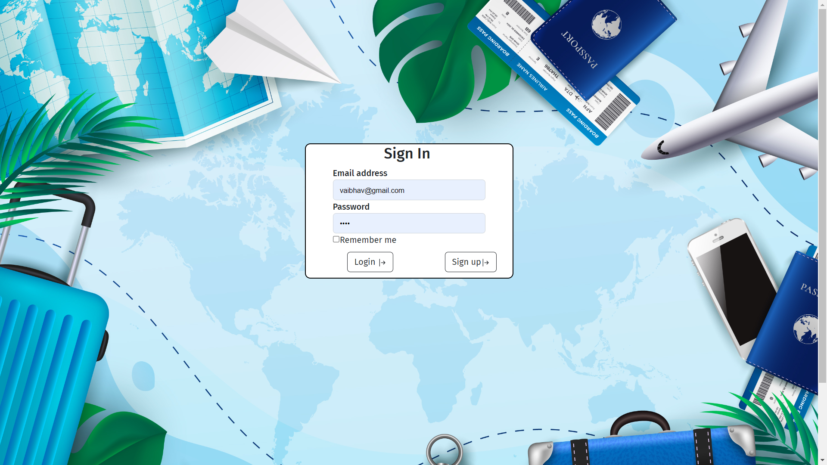
Login Page
All users can login separately and maintain their account info separately

Slide 18
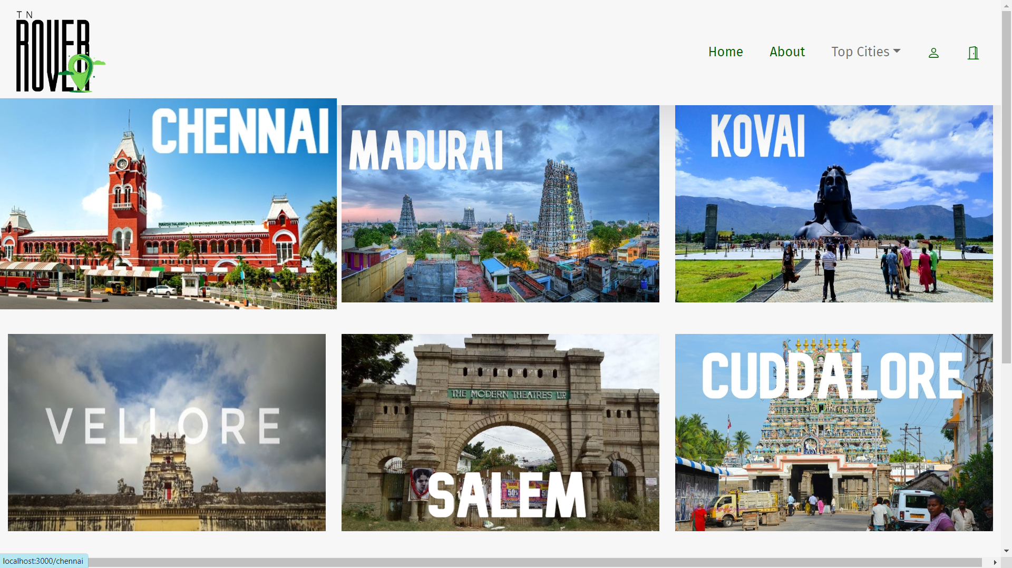
Home Page
The app should take the user to the home screen where they have can find the various famous cities in Tamil Nadu

Slide 19
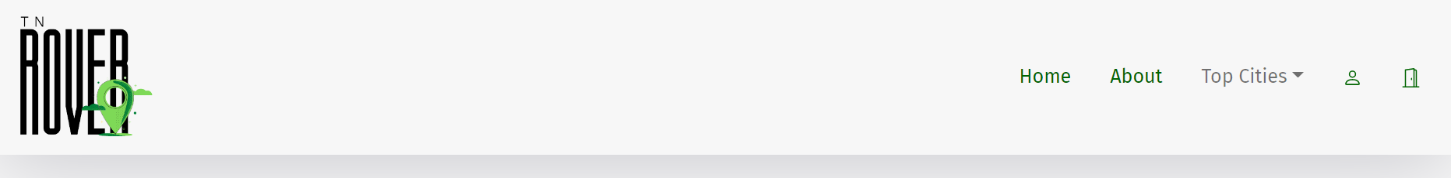
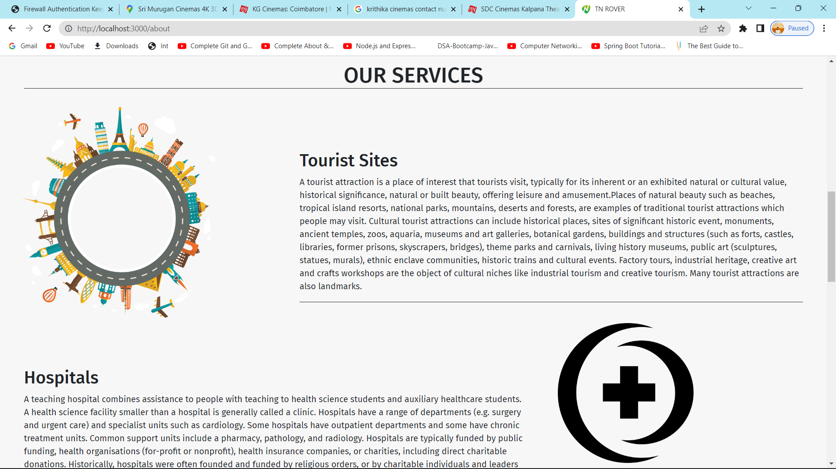
About Page
The page allows all the users to know about the developers and the reason behind the development of this project.
Services provided by the project is enlisted.

Slide 20
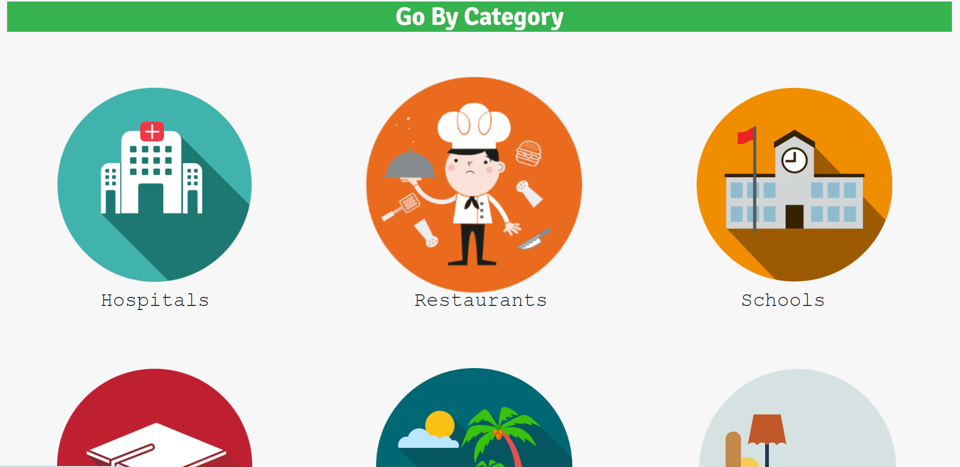
City Page
This module also contains the different amenities we need to know that are found in a city

Slide 21
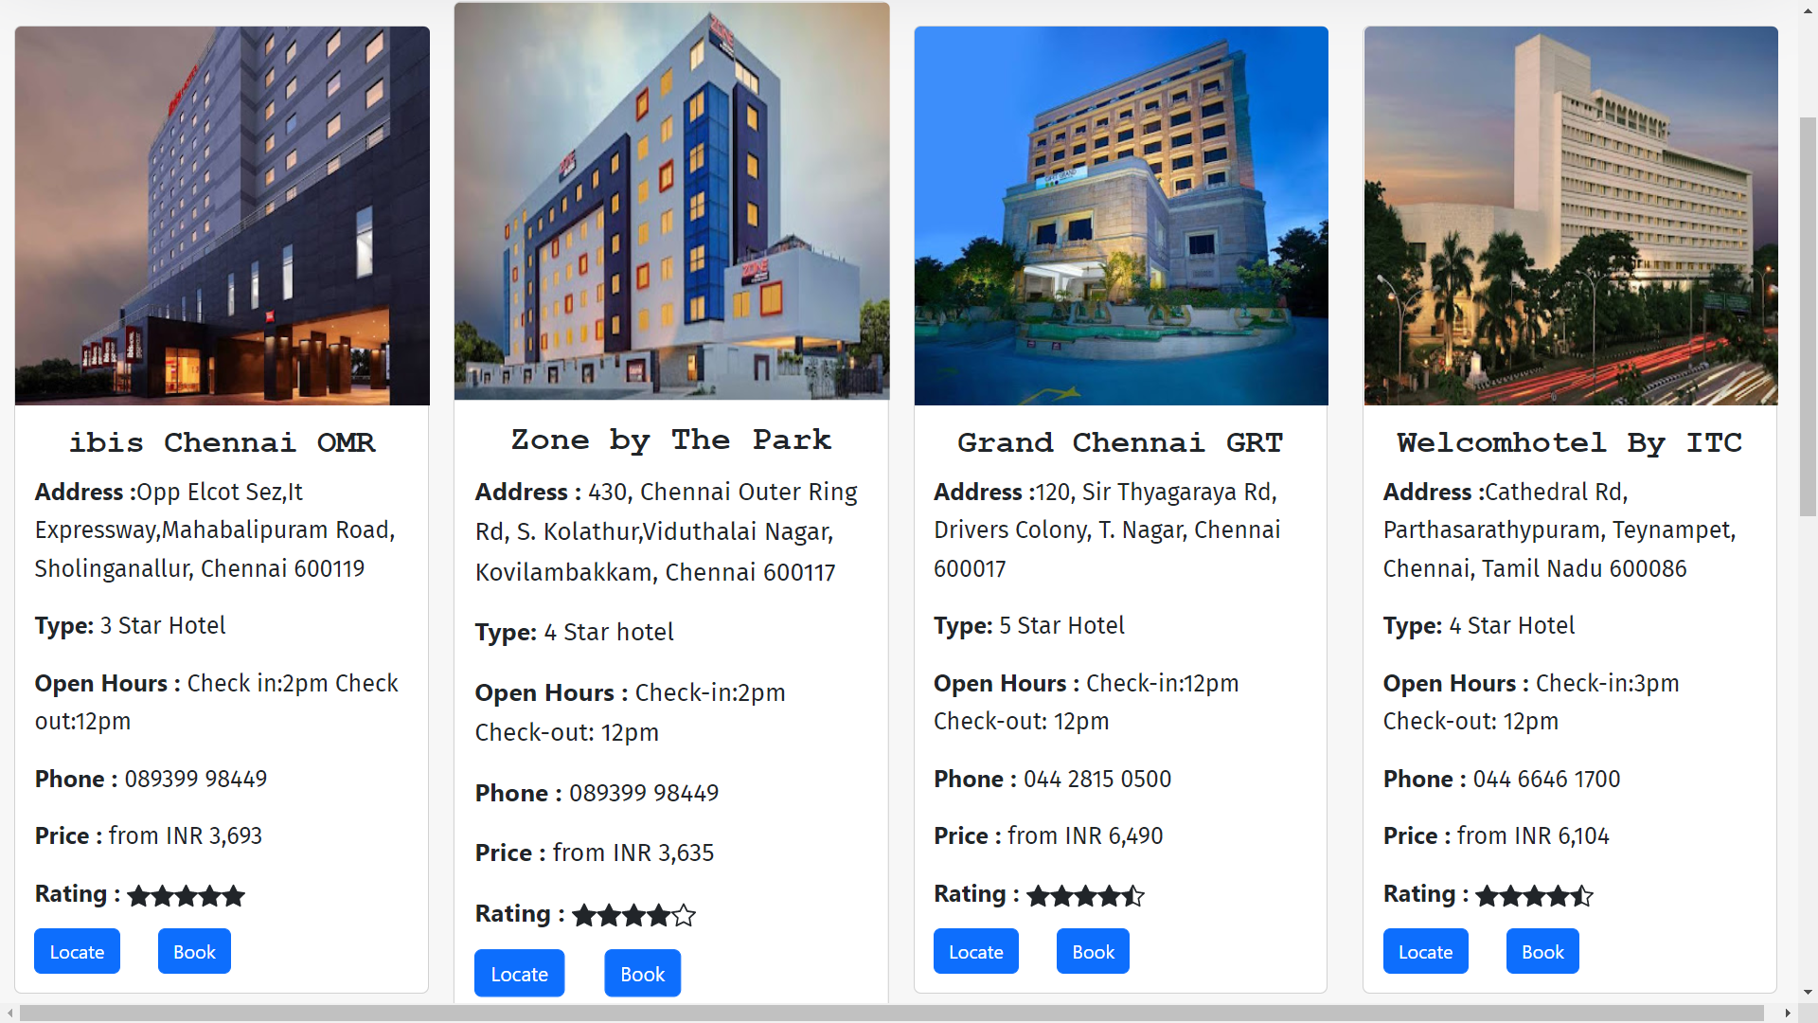
Hotel Page
In each images caption the address and contact info is also provided above review and location part

Slide 22
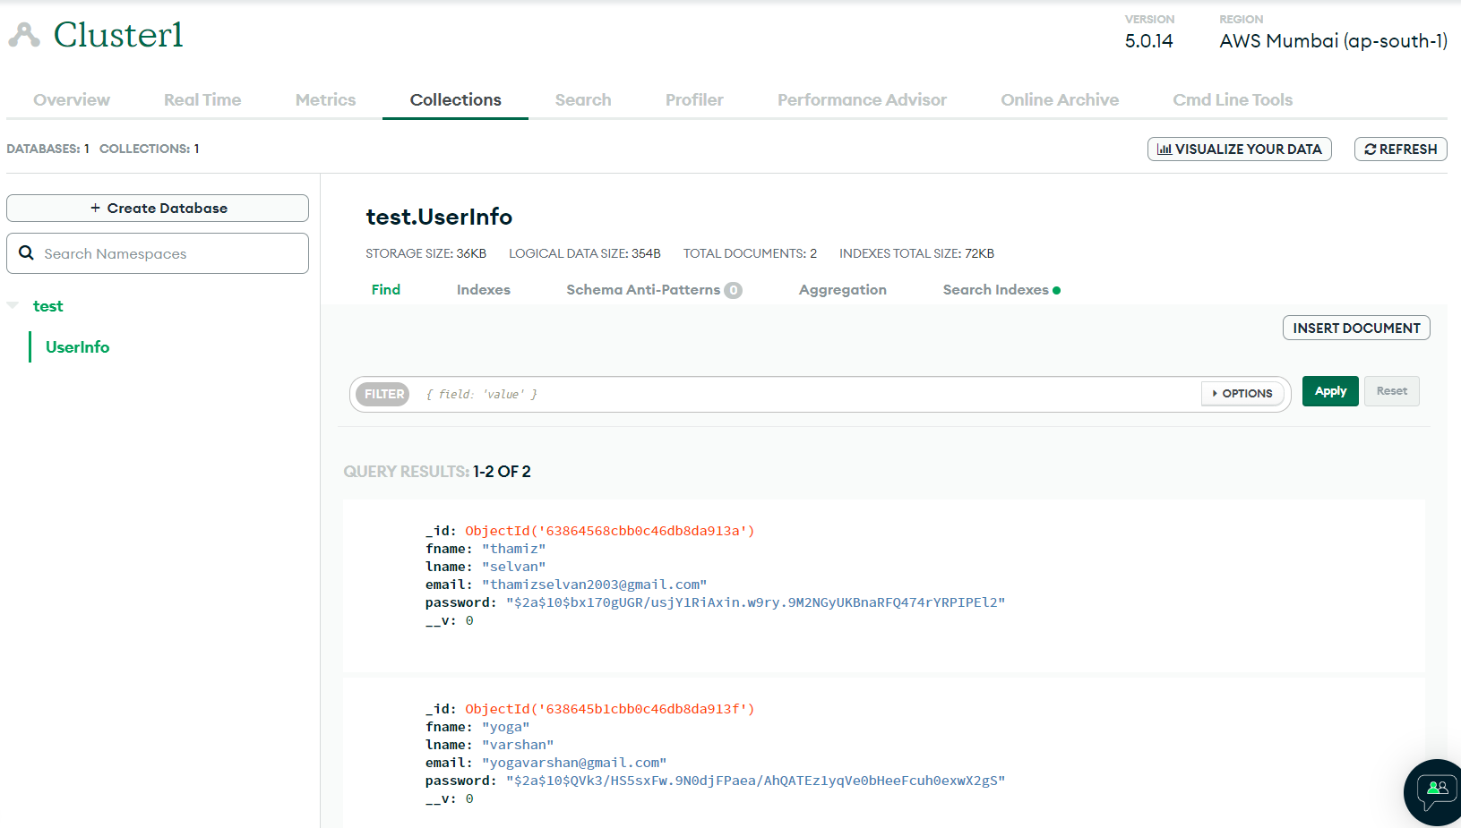
Database
The login details of each user have been stored in the cloud.
Admin can modify or retrieve the details.

Slide 23
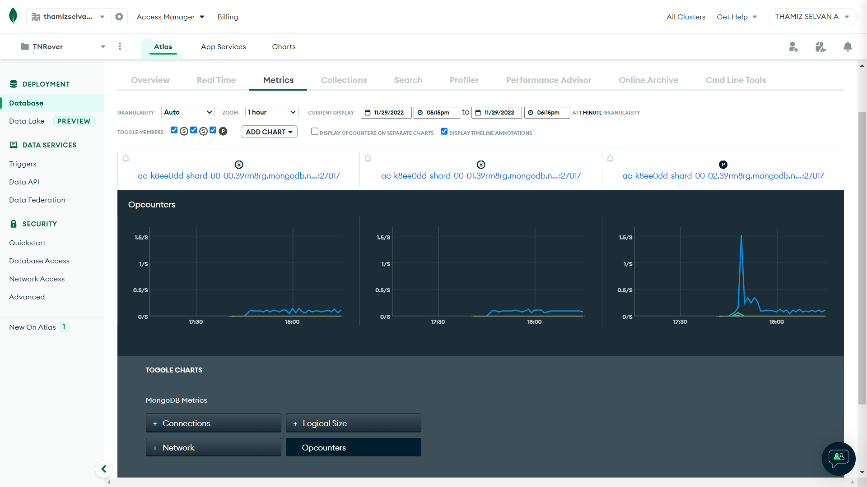
Database
Usage stats of the database by the user or admin is also monitored in the cloud.

Slide 24
THANK YOU

